Slide 1

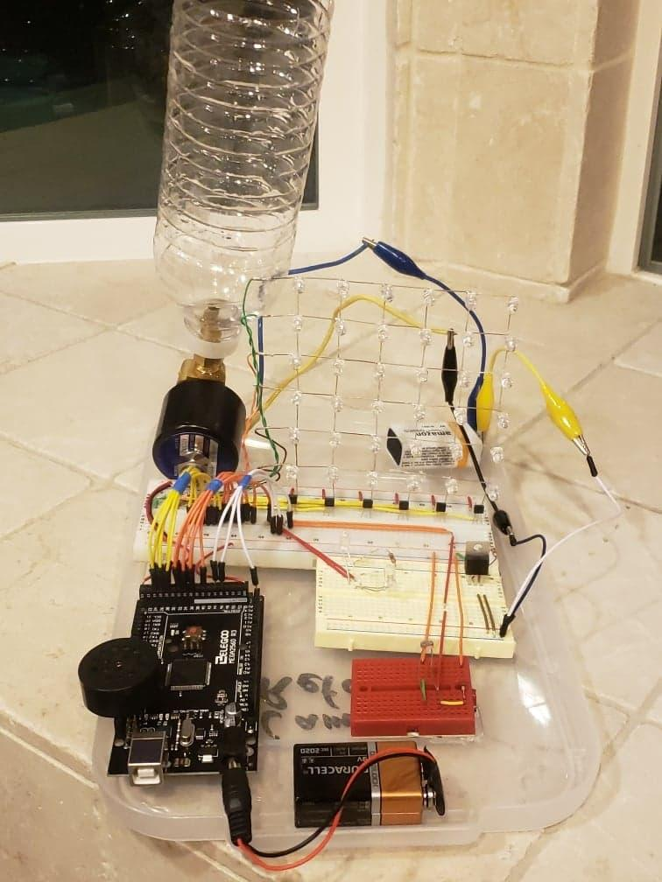
Team 9: Evan Chou, Jordan Masutomi, AND Cameron rafaee
Final Prototype
YOU SNOOZE YOU LOSE
Our Mission: To build an alarm clock that will go to great lengths to wake you up.
Hardware Needed:
-photoresistor (sunrise alarm)
-jumper wires
-small breadboard
-large breadboard
-Arduino and 9V battery
-solenoid valve (for bottled water alarm)
-36 LEDs (optical alarm)
-piezospeaker (audible alarm)
-6 transistors
Our Vision: An audible, optical, and water alarm will go off at the same time, creating chaos and forcing individuals to wake up
HOW DOES IT WORK?
An alarm sounded through a speaker will be triggered from an Arduino program which will result in an activation of a solenoid valve. The solenoid valve is designed to splash the person sleeping, so he or she will wake up regardless of how tired he or she is; this will be the last resort if an audible or optical alarm is not effective. The alarms will be turned on and off with an Arduino program. If/else statements will be used to control the alarms and stopping the clock if the user covers a photoresistor. Specifically, the alarm will start at sunrise when the photoresistor detects light.

